Slide 1
World Rugby U20 Championship

Slide 2
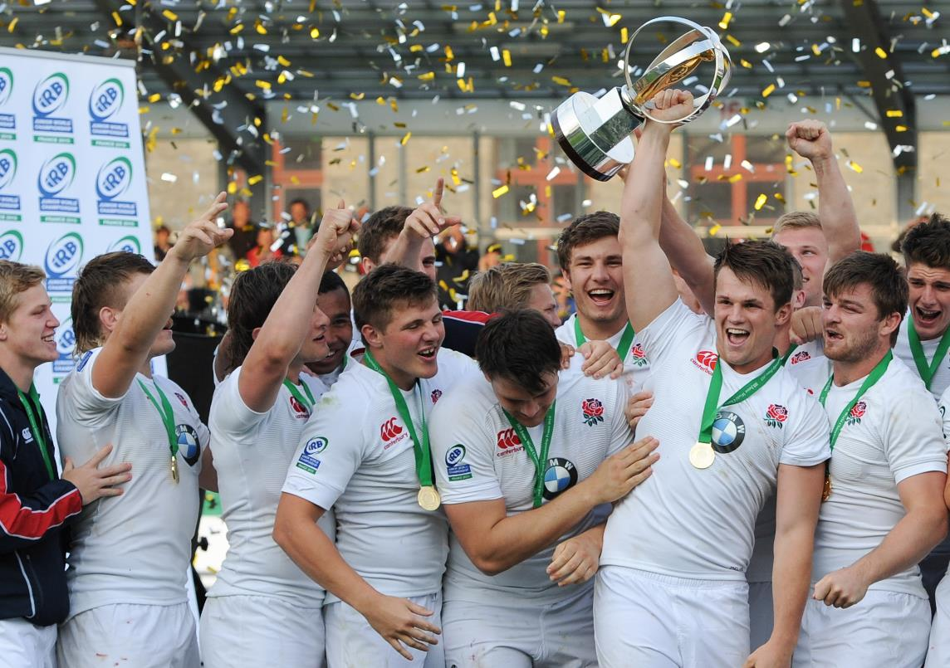
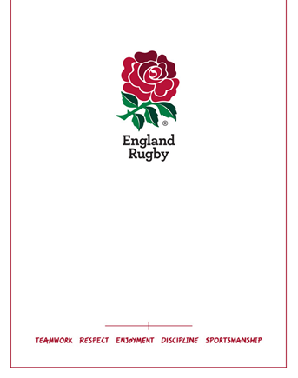
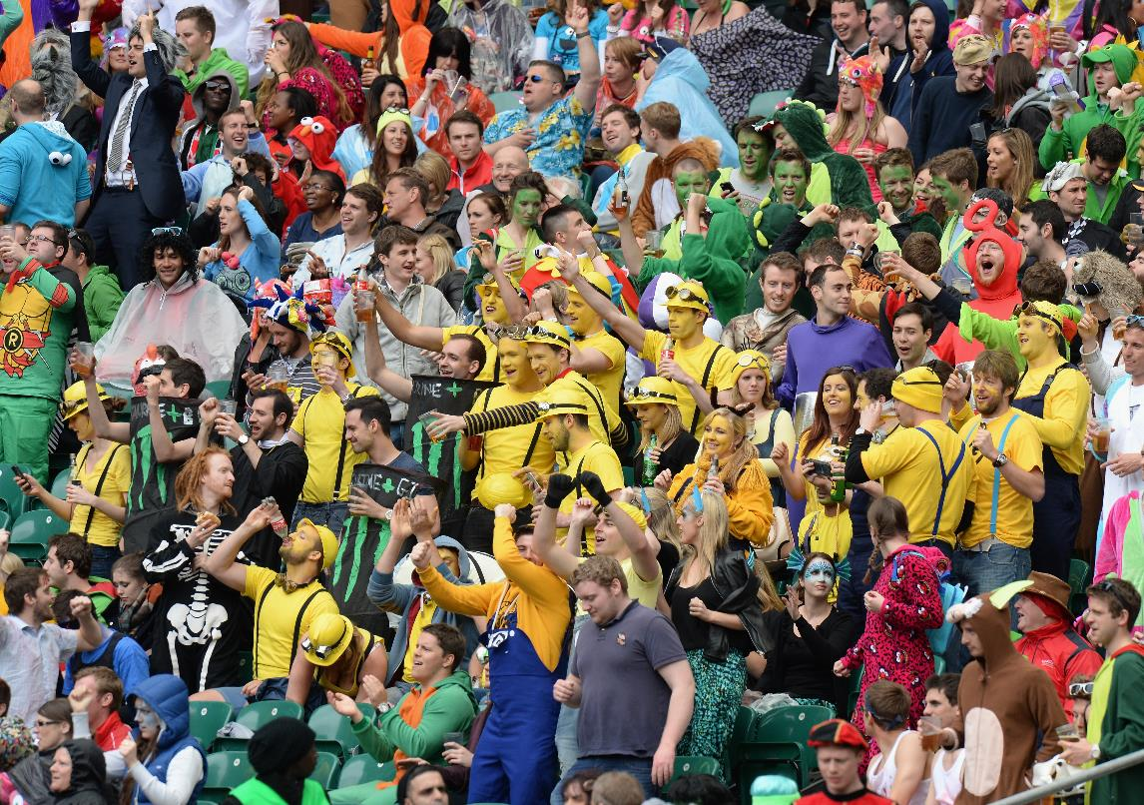
The Theme and Activation
WORLD RUGBY U20s

Slide 3
WHAT IS THE WORLD RUGBY U20 CHAMPIONSHIP
The Rugby Football Union will host the World Rugby U20 Championship and will take place at the Academy Stadium, Manchester and the AJ Bell Stadium, Salford from 7th June to 25th June 2016.
With the future stars of world rugby heading to the Greater Manchester area for nearly a month, the tournament promises to be an all action event, showcasing some of the finest talent on the planet.
After the recent tournament in Italy in June 2015, the World Rugby U20 Championship will land in Manchester and Salford, with England coming into their home tournament as winners of 2 of the last 3 events. As 2015 Rugby World Cup host city, The Academy Stadium and AJ Bell Stadium are ideally placed amongst a hot bed of sport in the North West, creating an ideal opportunity for supporters from around the region, and further afield, to enjoy international rugby following the Rugby World Cup in 2015.

Slide 4
WHAT IS THE WORLD RUGBY U20 CHAMPIONSHIP
2016 tournament dates
Pool Stage 1, Tuesday 7 June
Pool Stage 2, Saturday 11 June
Pool Stage 3, Wednesday 15 June
Semi-finals, Monday 20 June
Finals, Saturday 25 June
12-team international men’s rugby tournament played over 5 match days.
Pool A: New Zealand, Ireland, Wales, Georgia,
Pool B: England, Australia, Scotland, Italy,
Pool C: South Africa, France, Argentina and Japan
5 match days
12 teams
6 matches per match day
Potential for 100,000 people to watch the tournament.

Slide 5
WORLD RUGBY U20 CHAMPIONSHIP – WHAT DOES SUCCESS LOOK LIKE?
Target of 5,000 – 8,000 tickets sold per venue, per match day.
Raise the profile of the event and the sport with media and fans
Creating the ultimate fan experience
Engaging with the rugby family in Lancashire, Cheshire, Cumbria and Yorkshire
Raise the profile of the event and the sport in the NW
Drive participation in the game at a playing, coaching and volunteer level
Build a world class event
Enhances local ties and drive local involvement.
That we set the standard for future World Rugby U20 Championship’s

Slide 6

2016 CAMPAIGN CREATIVE
First of 5 creatives
Ad featured in the programme at the Rugby World Cup Fan Zones. Circulation of 240,000 across the tournament.
Additional versions to feature the following:
England
Pool Stage Match Ups x3
Home Nations match day (Saturday 11th June)
Working with World Rugby on their position for the event ‘The future stars of World Rugby’
The colour palette will form the foundation of city dressing and the overall brand identity for the tournament.

Slide 7

2016 CAMPAIGN CREATIVE – OUTDOOR CREATIVE

Slide 8


2016 CAMPAIGN CREATIVE – OUTDOOR CREATIVE

Slide 9

2016 CAMPAIGN CREATIVE – DIGITAL CREATIVE
To be supplied to clubs via the clubs digi pack.

